Slide 1

FINAL PRESENTATION
TEAM EXPONENTIAL
Borislav Pavlov, Kim Young Oh, Park Geo Ryang, Kim Min Jae

Slide 2
OBJECTIVE
Stock-loss Prevention: Mobile Application with CNN-LSTM Model for Predicting Sharp Rises and Falls in Stock Price

Slide 3
PROJECT PROGRESS

Slide 4
SCHEDULE
PART | CONTENT | SCHEDULE
 |  | MONTH | 9 | 10 |  |  |  | 11 |  |  |  | 12
 |  | WEEK | 4 | 1 | 2 | 3 | 4 | 1 | 2 | 3 | 4 | 1 | 2 | 3
AI | Research on thesis
 | Use and modification of the AI model code
 | Apply explainable AI, GradCAM
 | performance improvement
Mobile Application – Research & Design | Research a framework
 | Research a Websocket
 | Create initial wireframes for the mobile application
Mobile Application – Implementation & Testing | Implement the initial design view of the application and state management
 | Implement WebSocket service
Backend API | Research
 | Implementation
 | Testing

Slide 5
TEAM ROLES
Team Lead: Borislav Pavlov
AI Algorithms:
Main - Kim Young Oh, Kim Min Jae
Supported – Borislav Pavlov, Park Geo Ryang
Mobile Application + Additional Services
Main - Borislav Pavlov, Park Geo Ryang
Supported - Kim Young Oh, Kim Min Jae

Slide 6
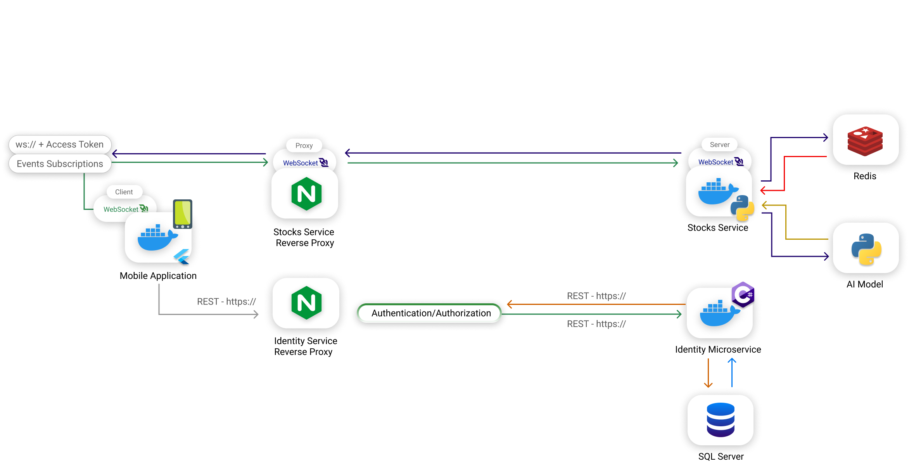
INITIAL DESIGN

Slide 7
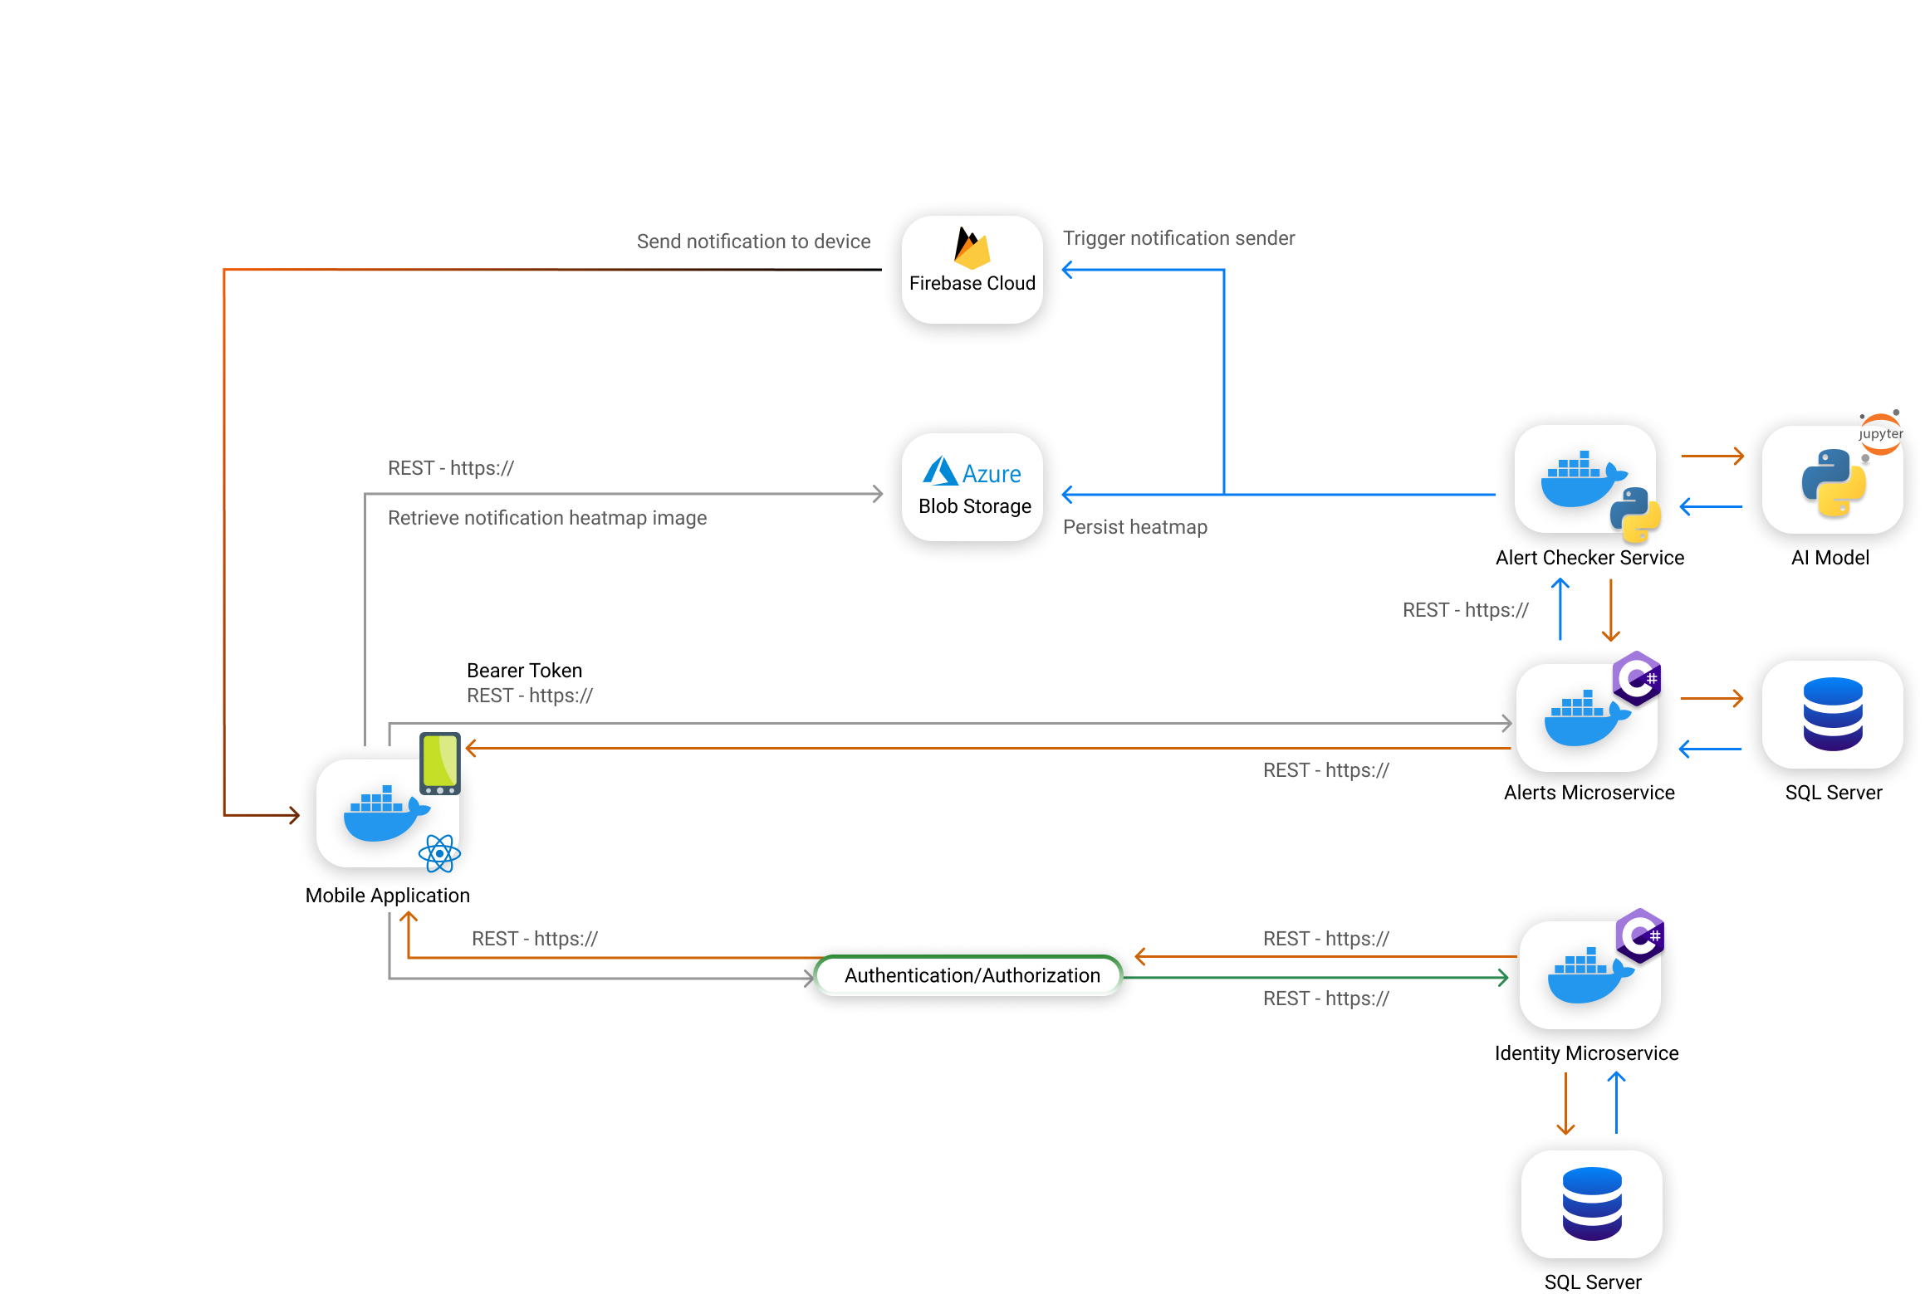
FINAL DESIGN

Slide 8
FINAL IMPLEMENTATION

Slide 9
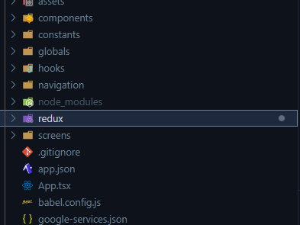
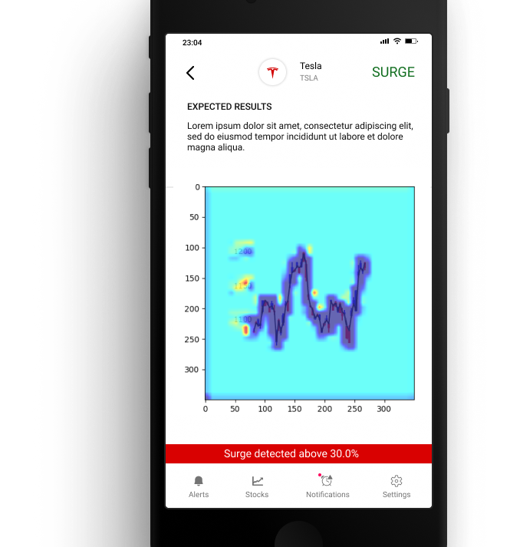





FINAL IMPLEMENTATION – MOBILE APPLICATION

Slide 10
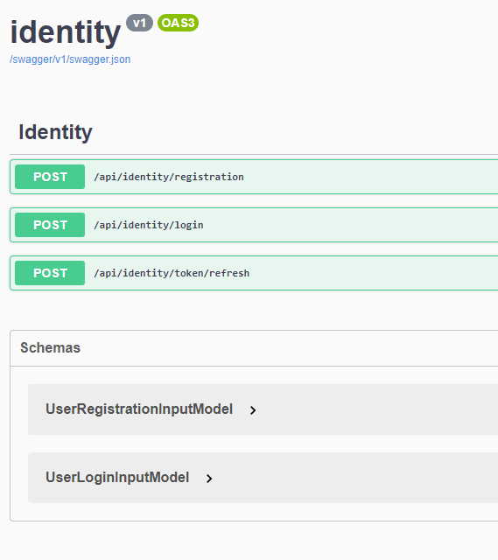
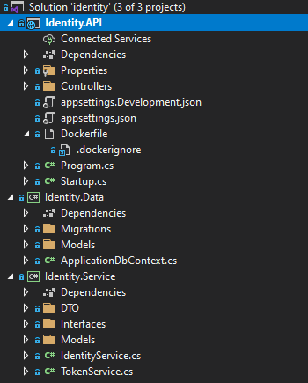

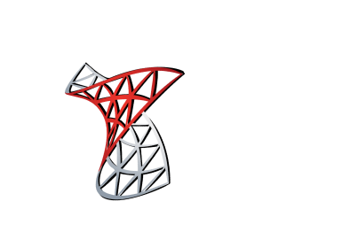


FINAL IMPLEMENTATION IDENTITY SERVICE

Slide 11
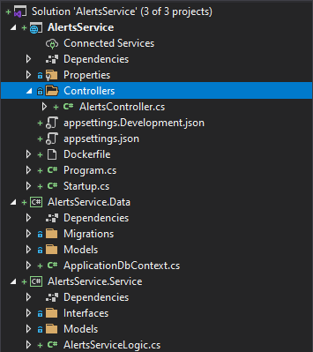
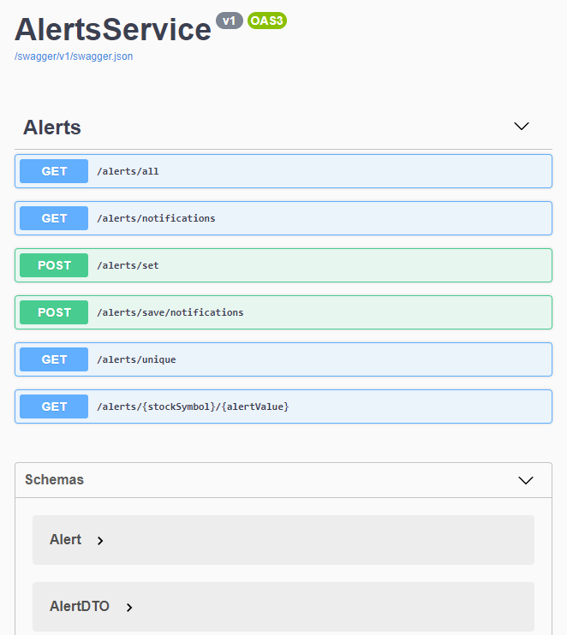
FINAL IMPLEMENTATION ALERTS SERVICE

Slide 12
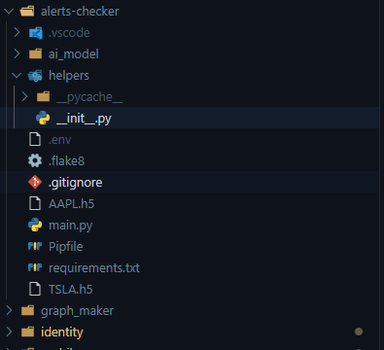
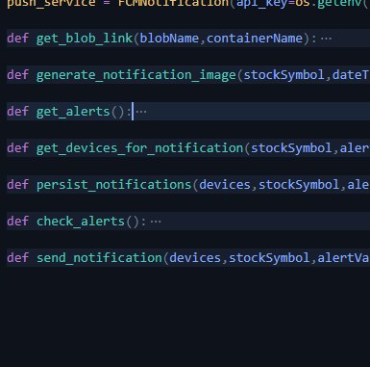




FINAL IMPLEMENTATION ALERTS CHEKER SERVICE

Slide 13
CHALLENGES
MOBILE APPLICATION
Refactoring because of unnecessary socket implementation
Integration of notifications - ejecting expo project because expo notifications does not support emulators
Initial state management setup
ALERTS CHECKER SERVICE
Persisting AI Model heatmap images to external storage provider
Sending notifications
Performance optimization
AI MODEL
Even though the original author's code was used as it is, the loss is large, so we are thinking about whether to find another model or use it as it is.

Slide 14

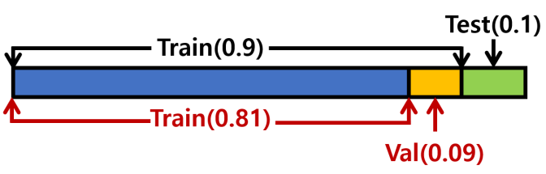
DATASET
YFINANCE
To retrieve stock price information
Corpus
The input dataset consisted of 1744 CNNs and LSTMs
The ratio of train:validation:test was 0.81: 0.09: 0.1

Slide 15
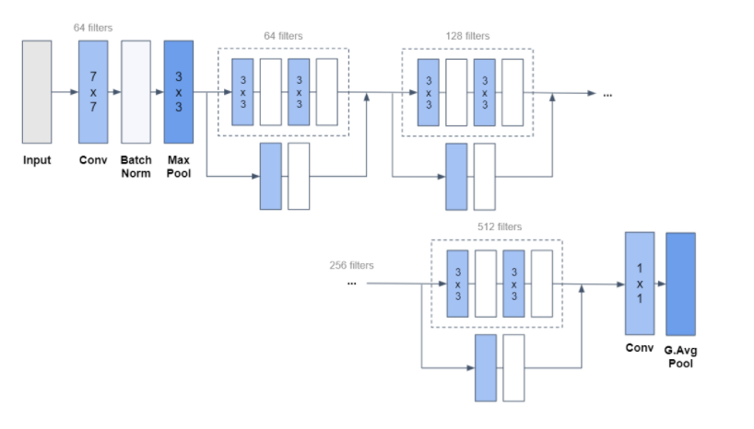
MODEL DESCRIPTION
CNN
Resnet structure
1 convolutional layer + 16 Resnet block + 1 convolution layer

Slide 16
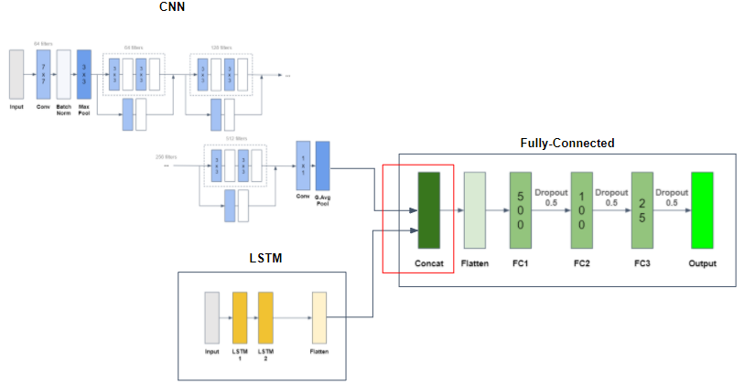
MODEL DESCRIPTION
LSTM
2 Layer
Concatenation
CNN and LSTM join FNN through Flattern and produce predictions

Slide 17
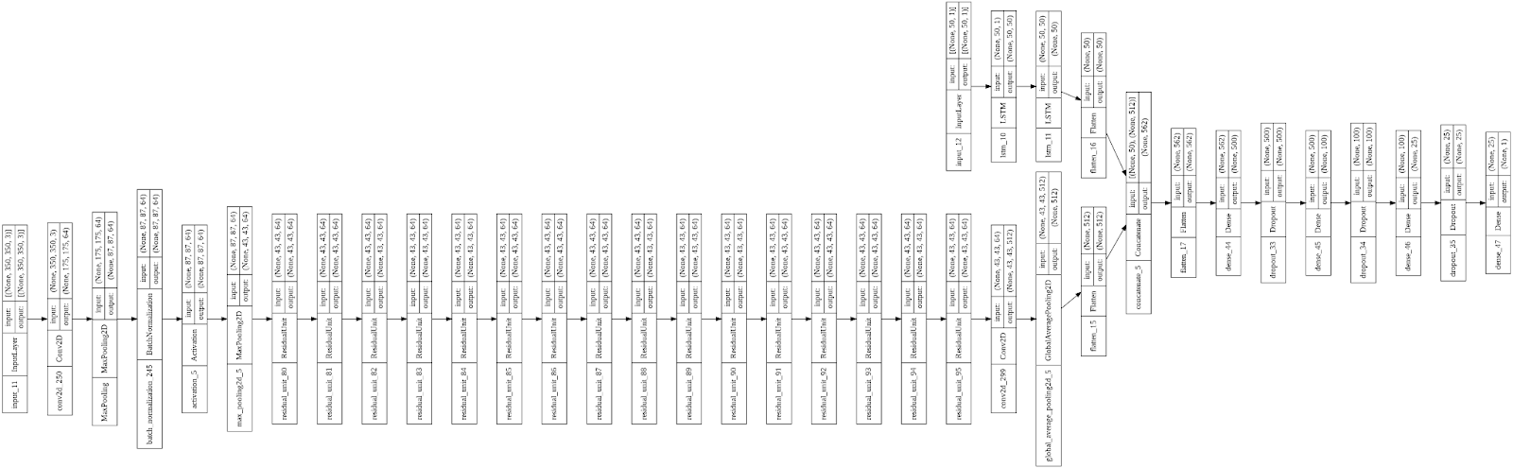
MODEL DESCRIPTION
Schematic diagram

Slide 18
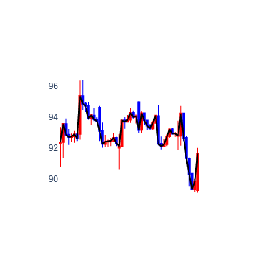
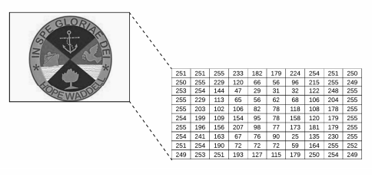
INPUT AND OUTPUT
INPUT
CNN
Candlestick chart that contains information on close, open, high, low stock prices
Stock chart image is converted into a numpy array
LSTM
Closing price data
Use log10 value

Slide 19
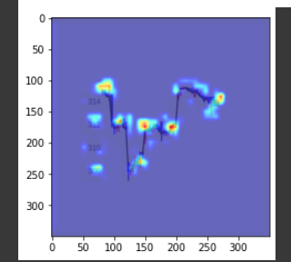

INPUT AND OUTPUT
OUTPUT
Gradient CAM - Heat Map
Processing about log10 and correction are performed on the finally derived prediction

Slide 20
EVALUATION METRICS
Evaluation Metrics for ML
Epoch: between 20 and 30
loss(mse): 0.1524
mape: 11.9957
rmse: 0.3904
val_loss: 0.0050
val_mape: 2.3413
val_rmse: 0.0706

Slide 21
MAIN HYPERPARAMETERS
Batch size
32
Epoch
It was set to between 20 and 30 due to overfitting and underfitting
Value correction
When the forecast is low
Multiply by gap_avg * (1+Standard Deviation)
When the forecast is higher
Devide by gap_avg * (1-Standard Deviation)

Slide 22
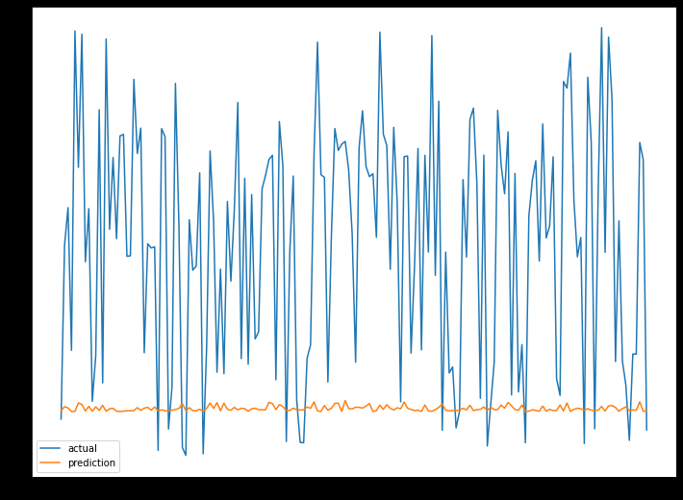
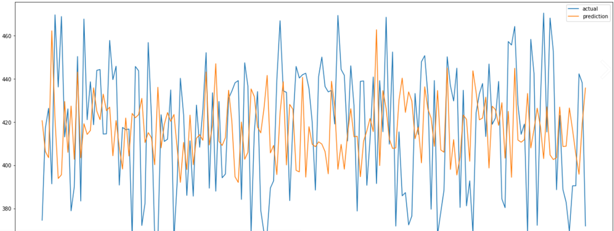
MAIN HYPERPARAMETERS
Result of value correction

Slide 23
LIMITATIONS
MOBILE APPLICATION
Not entirely native
ALERTS CHECKER SERVICE
Each check must wait the previous to finish, and it can be slowly sometimes if there are many users subscribed to the same alert because the sending of notifications is included in the service
AI MODEL
Overfitting & underfitting case
Approximate and consistent errors between stock price predictions and actual values

Slide 24
EVALUATION
Meet the objective of the project
Application users can set alerts and receive notifications for set stock items
Reasons for low predictive rate
Uncertain fluctuations in stock prices
Difference in layer depth between CNN and LSTM
Fast overfitting due to sequential input dataset
Low learning rate due to small epoch value
1 hour data used in train process, but 15 minute data used in evaluate

Slide 25
DEMO

Slide 26
Q & A

